Slide 1
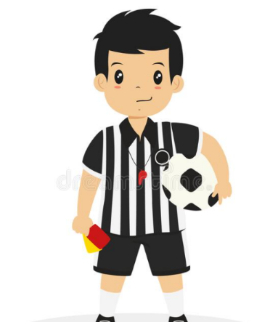
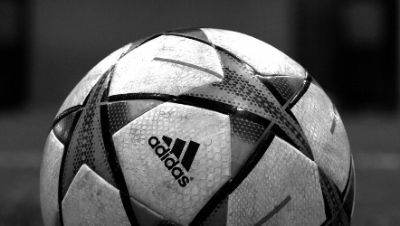
Consider becoming a soccer referee for the 2021-2022 season

Slide 2
Reasons to become a Soccer Referee
Friendship
Becoming a soccer official is a great way to meet friends that have similar interests. Working with different referees helps you understand how different people can be so much like you.
Knowledge
Complete knowledge of the game can help you become a better player.
Money
You can work a few hours and make some pretty good money.
Have some fun
Refereeing a soccer game is good exercise, you can be outside, run around, and enjoy some exciting games.

Slide 3
Information for becoming a Soccer Referee
Your resource to become a soccer referee in Rhode Island:
www.risrc.net
Competitive Soccer
To ref these games you must be at least 13 years old
Recreational / Town Leagues
no age restriction (you will ref a younger age group than yourself)
You will begin reffing with an older ref to learn how
Contact for more information
Ted Allgair
NSYSA Coordinator
NSYSARef@nsysa.org

Slide 4
Steps to become a Soccer Referee
Step 1 – Go to http://www.risrc.net/referees/new-referee-info/new-referee/ for complete information to become a referee in Rhode Island.
Step 2 – Create an account on the US Soccer Learning Center website (learning.ussoccer.com/referee). If you are over 18 years old, you will also need to complete a background check BEFORE you can register for any referee courses (the cost is usually around $30 and the background check is good for 2 years). It is recommended that people for whom this applies begin the process at least 2 to 3 weeks BEFORE the course date. US Soccer policy states that NO ONE can attend any in-person session unless the background check has cleared.
Step 3 – Once the background check is done (if you need it), you’ll be able to register for any New Grassroots Referee class. You’ll need to finish four online training modules before attending the in-person class. You can do the modules at your own pace, and you can stop/start as often as you’d like. The modules usually take about 4 hours total to complete.
Step 4 – Each New Grassroots Referee class has an in-person session where you will learn the basics of signals, positioning, how to use a whistle, and other referee-related skills. You will be asked to bring your whistle and a flag to the in-person clinic. Once the in-person clinic is completed and you’ve finished the online modules, you become a registered referee.

Slide 5
Referee Development
The purpose of the Grass Roots first time referee course is to prepare first time Grassroots referees to work in a competitive or recreational youth and amateur adult matches.
The goal of the First Time Grassroot Referee course is to broaden a candidate’s understanding on how to:
Facilitate a fair, fun, and safe game for the players by enforcing and applying the Laws of the Game
Make and clearly communicate decisions based on perception and interpretation of player’s actions
Facilitate understanding and application the Laws of the Game for players and coaches
On successful completion of the course, candidates will receive a Grassroots Referee license for the current registration year. Once the license and badge are received, Grassroots referees can officiate competitive, small-sided or recreational youth and amateur adult matches.

Slide 6
Looking the Part – Uniforms & accessories
Referee Uniforms: The RISRC suggests purchasing referee uniforms from Official Sports (https://officialsports.com)
It is suggested that you purchase the following (can be found on the site in a kit form):
A yellow shirt (either long or short sleeve, your preference)
Black socks
Black shorts
A whistle and a set of flags
A set of Yellow/Red cards
Other items that may be useful would be a second color shirt (we suggest black), match report forms (for inside the Yellow/Red card holders), and a duffel bag

